Slide 1

Digital Signal Processing
Course Instructor
Dr. Ali J. Abboud
Lecture No. 5: Fourier Transforms
Third Class
Department of Computer and Software Engineering
http://www.engineering.uodiyala.edu.iq/
https://www.facebook.com/Engineer.College1

Slide 2
Lecture Outline
Continuous Time Fourier Series
Discrete time Fourier series
Discrete Fourier Transform (DFT)
Fast Fourier Transform (FFT)
Decimation in time Fast Fourier Transform
Decimation in frequency Fast Fourier Transform
Dr. Ali J. Abboud

Slide 3
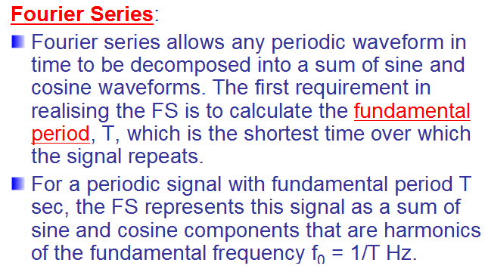
Fourier Series Representation
Dr. Ali J. Abboud

Slide 4
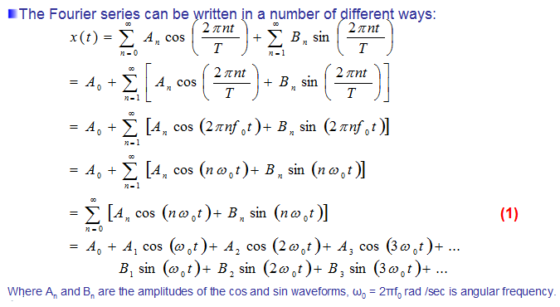
Fourier Series Representation
Dr. Ali J. Abboud

Slide 5
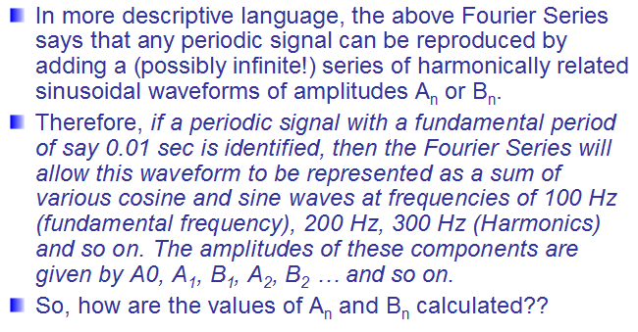
Fourier Series Representation
Dr. Ali J. Abboud

Slide 6
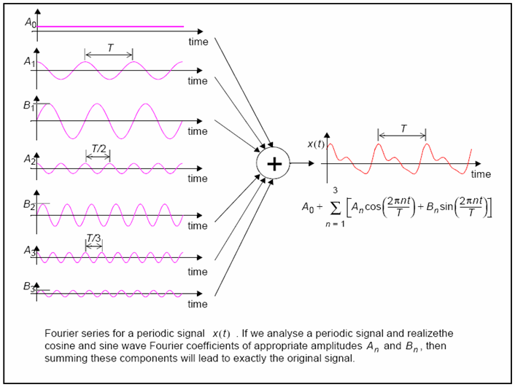
Fourier Series Representation
Dr. Ali J. Abboud

Slide 7
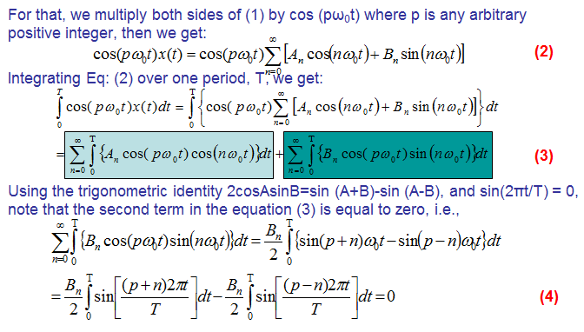
Fourier Series Representation
Dr. Ali J. Abboud

Slide 8
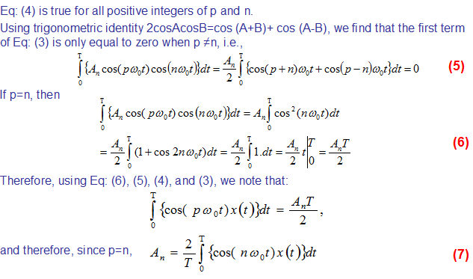
Fourier Series Representation
Dr. Ali J. Abboud

Slide 9
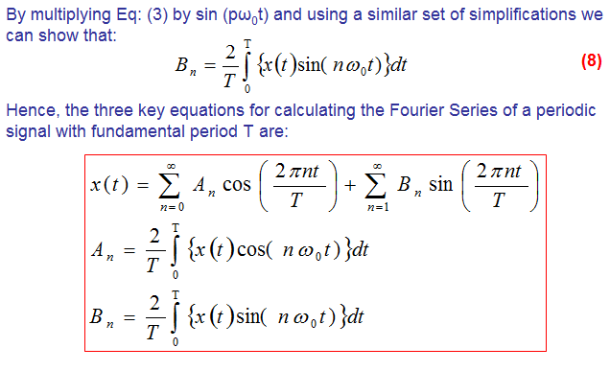
Fourier Series Representation
Dr. Ali J. Abboud

Slide 10
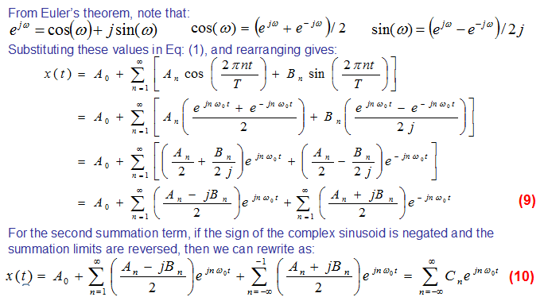
Complex Fourier Series
Dr. Ali J. Abboud

Slide 11
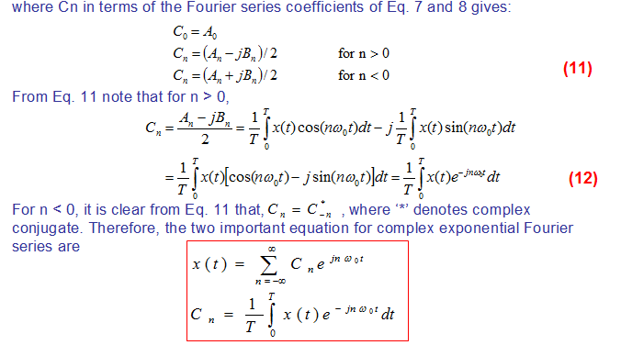
Complex Fourier Series
Dr. Ali J. Abboud

Slide 12
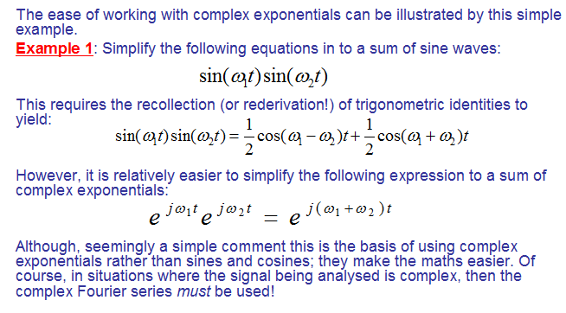
Example
Dr. Ali J. Abboud

Slide 13
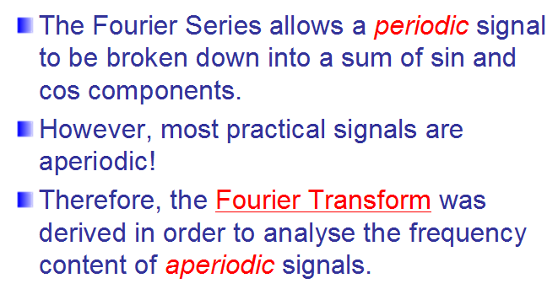
Fourier Transform
Dr. Ali J. Abboud

Slide 14
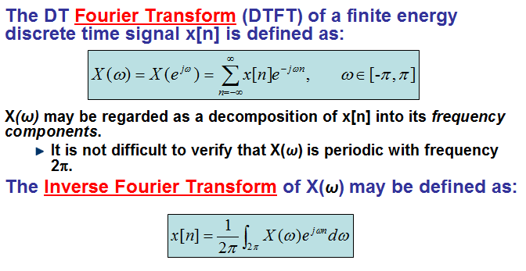
Discrete Fourier Transform
Dr. Ali J. Abboud

Slide 15
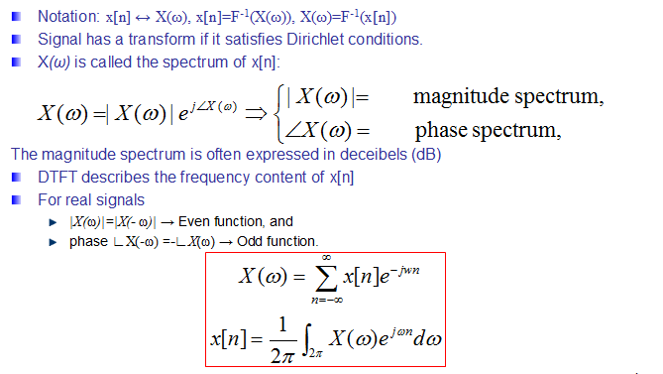
Discrete Fourier Transform
Dr. Ali J. Abboud

Slide 16
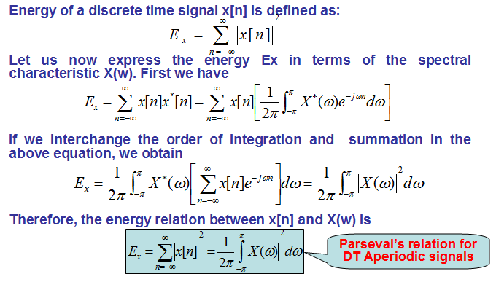
Energy Density Spectrum of Aperiodic Signals
Dr. Ali J. Abboud

Slide 17
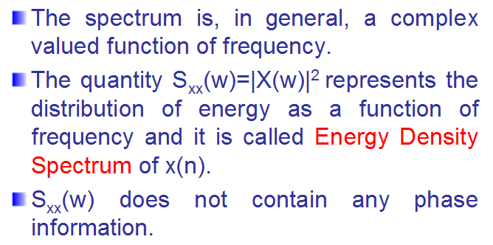
Energy Density Spectrum of Aperiodic Signals
Dr. Ali J. Abboud

Slide 18
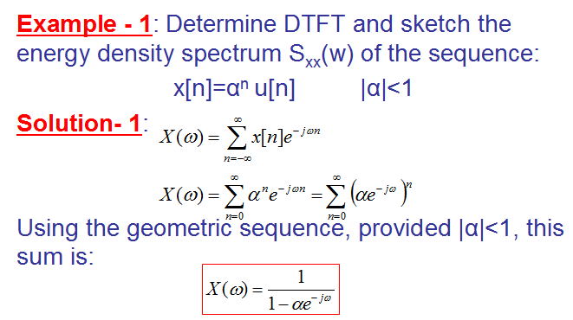
Energy Density Spectrum of Aperiodic Signals
Dr. Ali J. Abboud

Slide 19
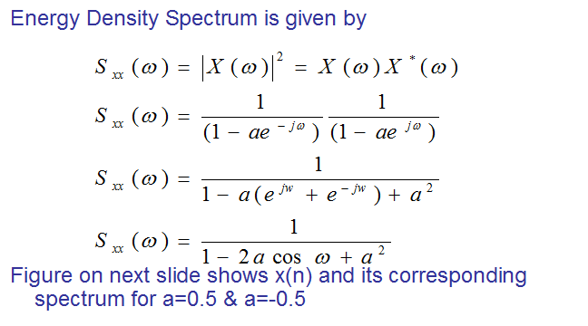
Energy Density Spectrum of Aperiodic Signals
Dr. Ali J. Abboud

Slide 20
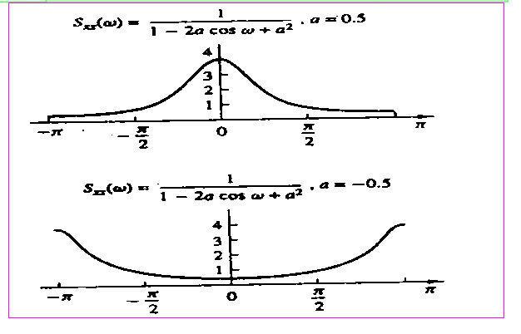
Energy Density Spectrum of Aperiodic Signals
Dr. Ali J. Abboud

Slide 21
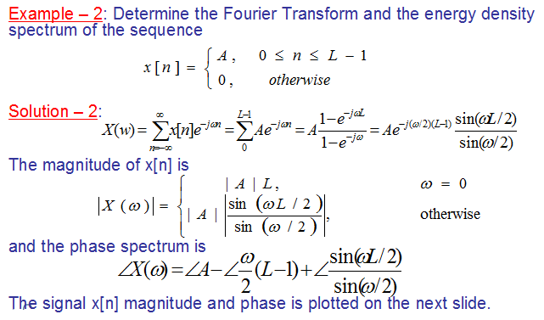
Energy Density Spectrum of Aperiodic Signals
Dr. Ali J. Abboud

Slide 22
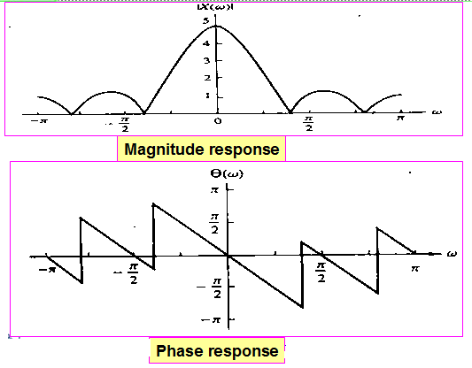
Energy Density Spectrum of Aperiodic Signals
Dr. Ali J. Abboud

Slide 23
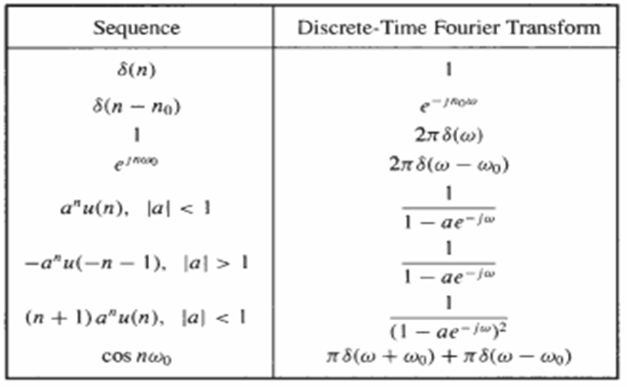
Some Common DTFT
Dr. Ali J. Abboud

Slide 24
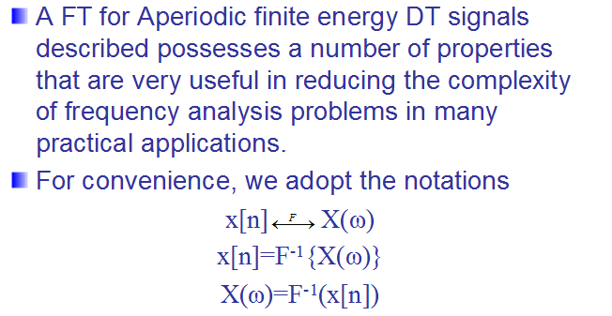
Properties of DTFT
Dr. Ali J. Abboud

Slide 25
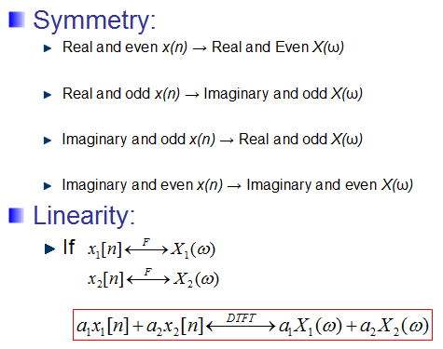
Properties of DTFT
Dr. Ali J. Abboud

Slide 26
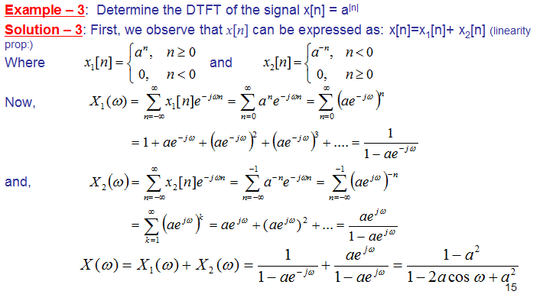
Properties of DTFT
Dr. Ali J. Abboud

Slide 27
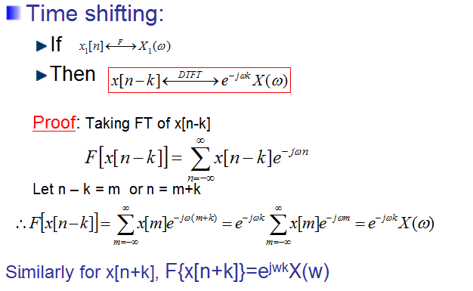
Properties of DTFT
Dr. Ali J. Abboud

Slide 28
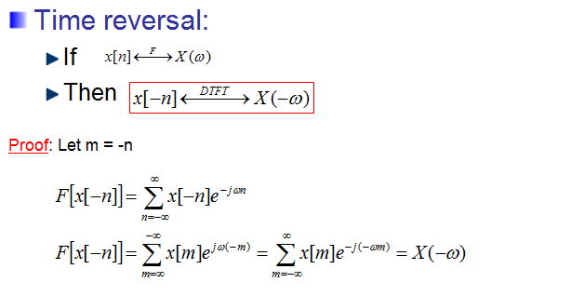
Properties of DTFT
Dr. Ali J. Abboud

Slide 29
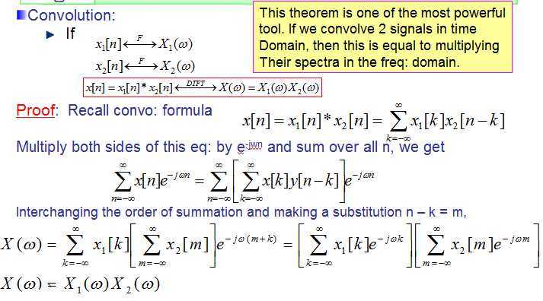
Properties of DTFT
Dr. Ali J. Abboud

Slide 30
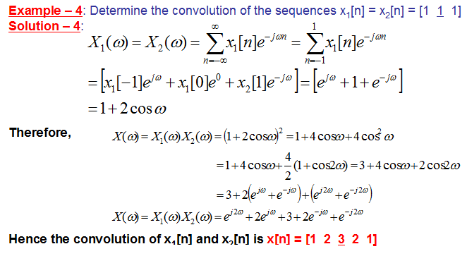
Properties of DTFT
Dr. Ali J. Abboud

Slide 31
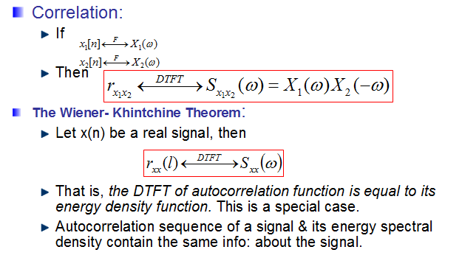
Properties of DTFT
Dr. Ali J. Abboud

Slide 32
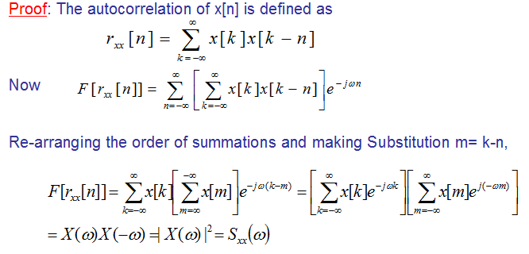
Properties of DTFT
Dr. Ali J. Abboud

Slide 33
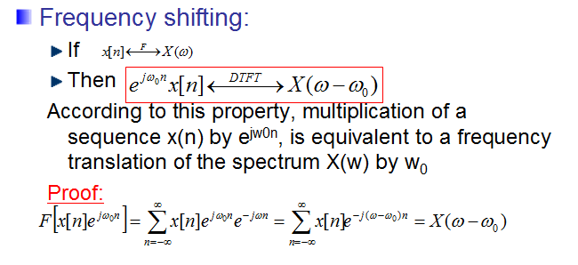
Properties of DTFT
Dr. Ali J. Abboud

Slide 34
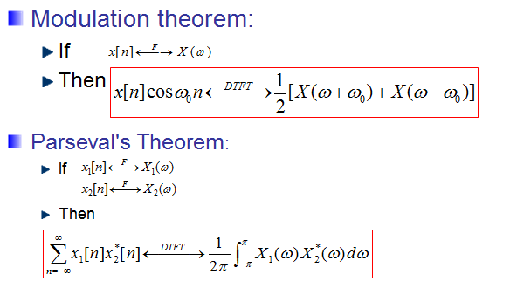
Properties of DTFT
Dr. Ali J. Abboud

Slide 35
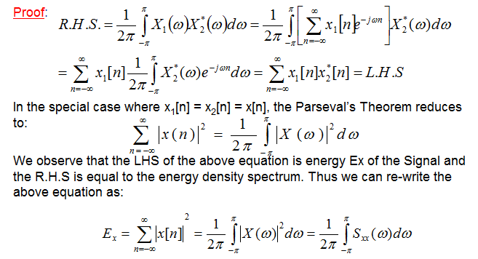
Properties of DTFT
Dr. Ali J. Abboud

Slide 36
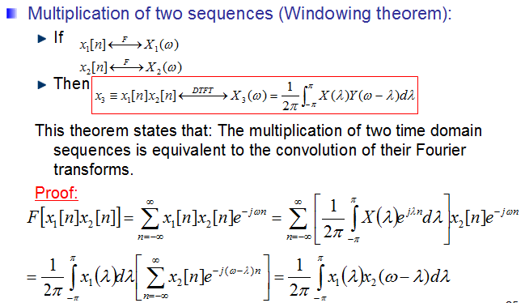
Properties of DTFT
Dr. Ali J. Abboud

Slide 37
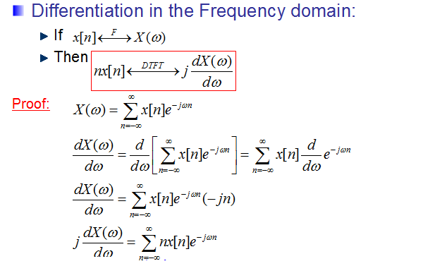
Properties of DTFT
Dr. Ali J. Abboud

Slide 38
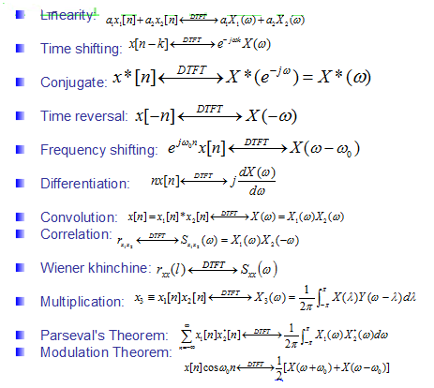
Properties of DTFT
Dr. Ali J. Abboud

Slide 39
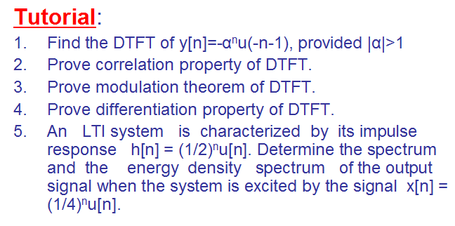
Properties of DTFT
Dr. Ali J. Abboud

Slide 40
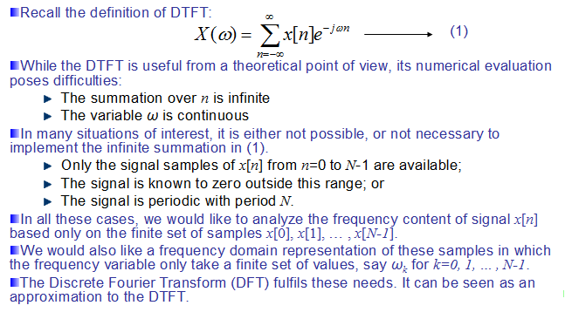
Discrete Fourier Transform
Dr. Ali J. Abboud

Slide 41
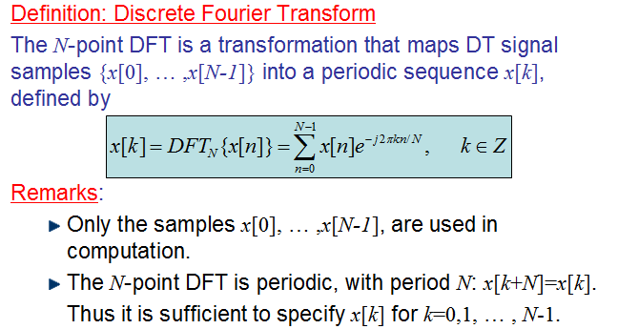
Discrete Fourier Transform
Dr. Ali J. Abboud

Slide 42
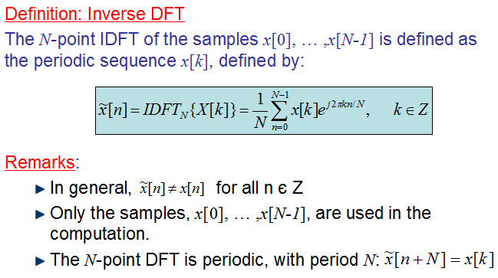
Inverse DFT (IDFT)
Dr. Ali J. Abboud

Slide 43
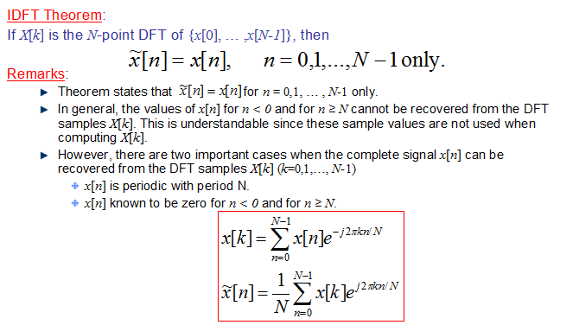
IDFT Theorem
Dr. Ali J. Abboud

Slide 44
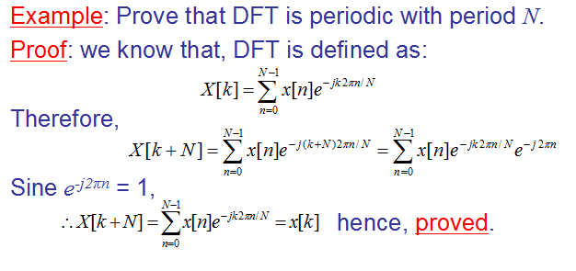
Example
Dr. Ali J. Abboud

Slide 45
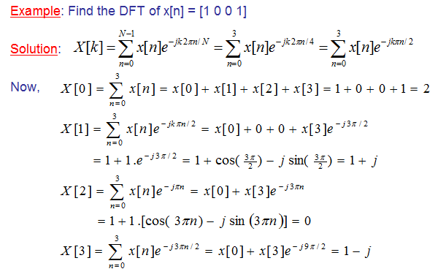
Example
Dr. Ali J. Abboud

Slide 46
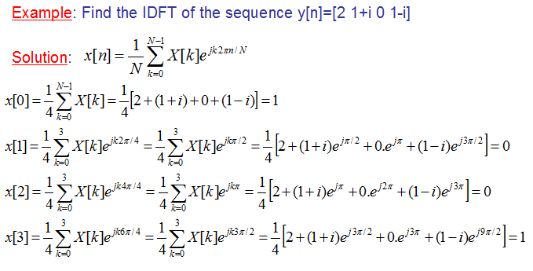
Example
Dr. Ali J. Abboud

Slide 47
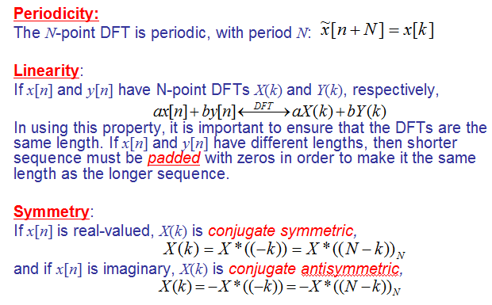
Properties of DFT
Dr. Ali J. Abboud

Slide 48
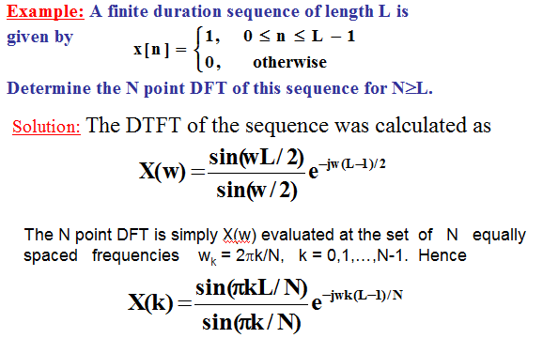
Example
Dr. Ali J. Abboud

Slide 49
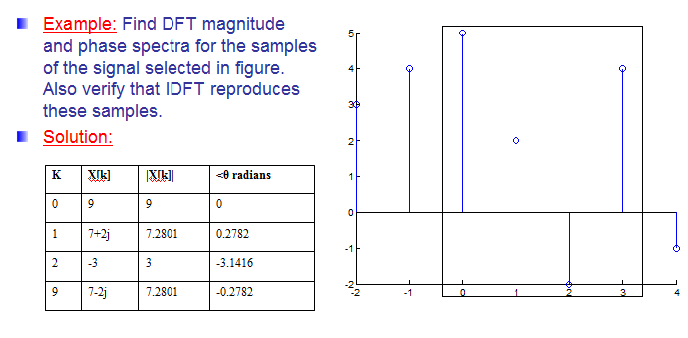
Example
Dr. Ali J. Abboud

Slide 50
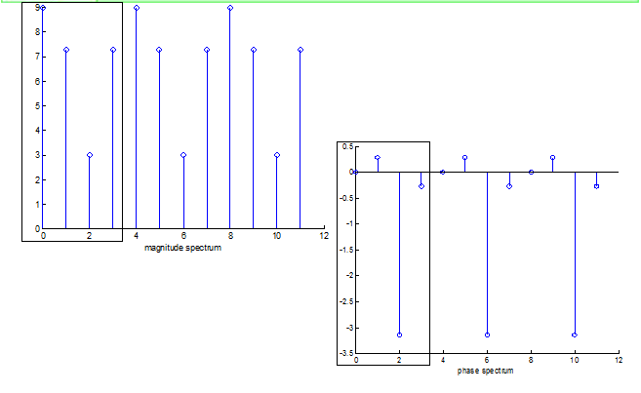
Example
Dr. Ali J. Abboud

Slide 51
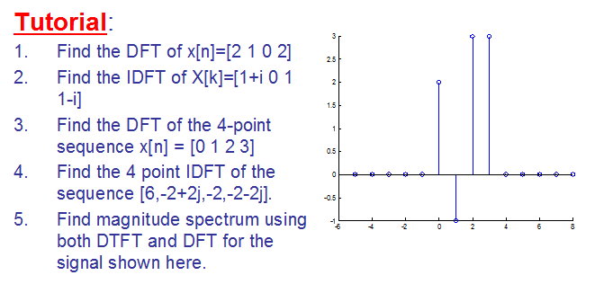
Example
Dr. Ali J. Abboud

Slide 52
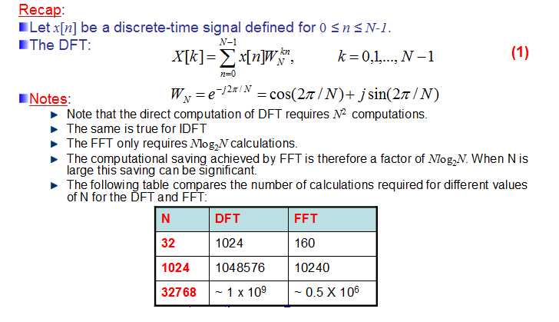
Fast Fourier Transform (FFT)
Dr. Ali J. Abboud

Slide 53

Fast Fourier Transform (FFT)
Dr. Ali J. Abboud

Slide 54

Example
Dr. Ali J. Abboud

Slide 55

Example
Dr. Ali J. Abboud

Slide 56

Different Types of FFT
Dr. Ali J. Abboud

Slide 57

Radix-2 FFT
Dr. Ali J. Abboud

Slide 58

Radix-2 FFT
Dr. Ali J. Abboud

Slide 59

Radix-2 FFT
Dr. Ali J. Abboud

Slide 60

2-Points FFT
Dr. Ali J. Abboud

Slide 61

“Butterfly” Signal Flow Graph
Dr. Ali J. Abboud

Slide 62

The 4-point FFT
Dr. Ali J. Abboud

Slide 63

The 4-point FFT
Dr. Ali J. Abboud

Slide 64

Radix-4 FFT
Dr. Ali J. Abboud

Slide 65

Radix-4 FFT
Dr. Ali J. Abboud

Slide 66

Split Radix FFT
Dr. Ali J. Abboud

Slide 67
End of Chapter
Dr. Ali J. Abboud

